Slide 1
Predicting Building’s EUI
Kevin Chew

Slide 2
What is EUI?
Energy Use Intensity
Measures the total energy consumed in a building in a year divided by its gross floor area
Indicator of the energy efficiency of a building’s design
Benchmark and compare energy use between buildings of similar operations

Slide 3



Problem Statement
Predict a building’s EUI using its building characteristics as well as weather data for the location of the building

Slide 4
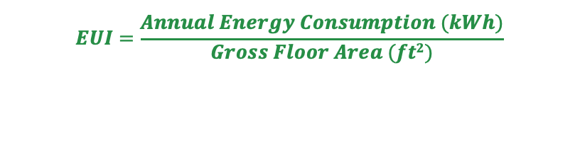
Value Proposition
EUI: 100
EUI: 60
$$EUI=\frac{Annual Energy Consumption (kWh)}{Gross Floor Area (ft2)}$$
Quickly access a building’s potential energy & cost savings
Stakeholders
Banks/Institutions
Policymakers
Building Owners

Slide 5
Dataset (taken from Kaggle)
64 Total Features
61 are Numeric
3 are Categorical
Data is centered on building’s characteristics and weather data
75,542 rows
Most are weather related, which covers:
Temperature
Degree Days
Fog
Precipitation
Snowfall
A few are building related, which covers:
Year built
Energy Star Rating
Floor Area
Elevation
All are building related, which are:
Facility Type
Building Class
State Factor (location)

Slide 6

EDA (Exploratory Data Analysis) – Key Findings
1. Buildings in certain States perform better
2. Buildings reside in a few different climates
3. Cold weather have a greater effect on EUI than warm weather
4. Age is a weak factor
5. Energy Star Rating is a big factor
6. Commercial Buildings score better than Residential Buildings
7. Type of facilities is important

Slide 7
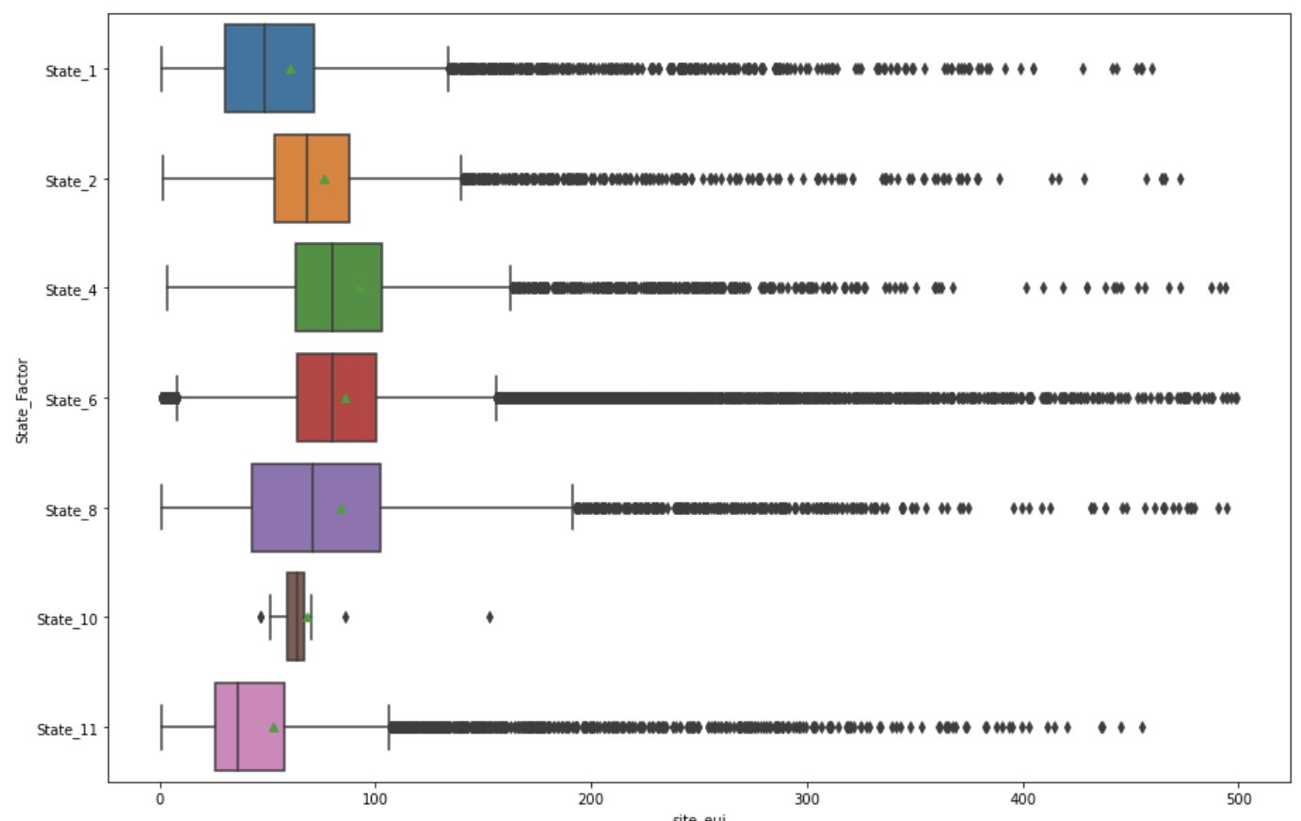
Buildings in certain States perform better
Takeaways:
Some states might be more progressive in their policies making towards climate action

Slide 8
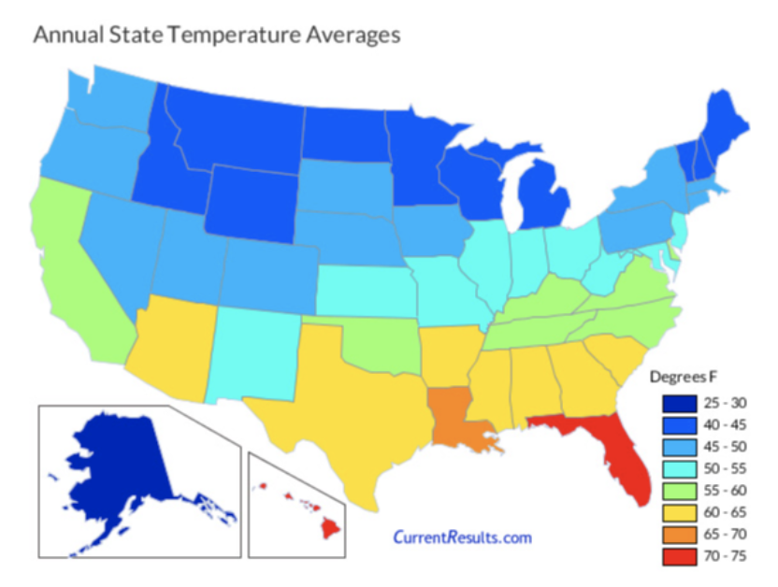
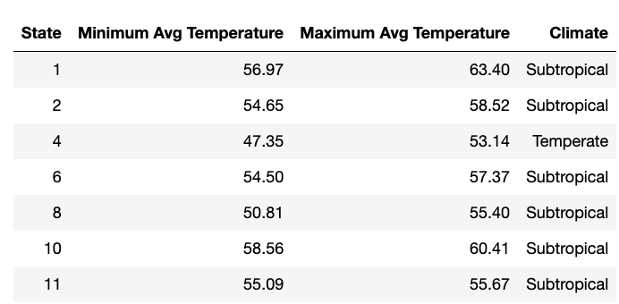
Buildings reside in different climates
Takeaways:
Some states are in Sub-Tropical climates (cool & mild winters)
Others are in Temperate climates (colder conditions in winter)

Slide 9
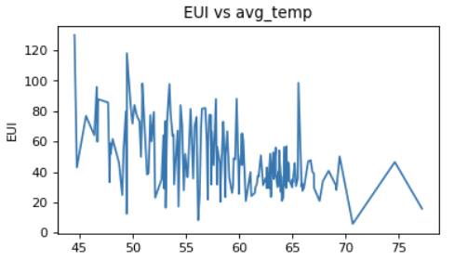
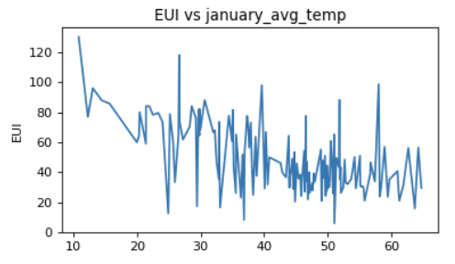
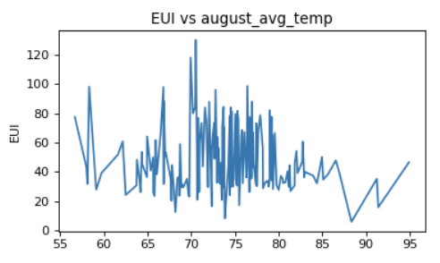
Cold weather have a greater effect on EUI than Warm weather
Takeaways:
Increased usage of heating appliances during colder temperatures contribute to higher EUI
During summer months, there is no distinct trend

Slide 10
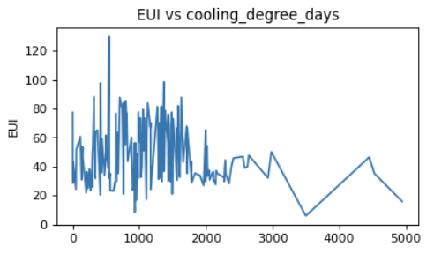
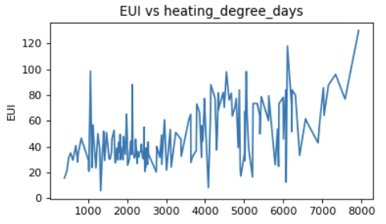
Cold weather have a greater effect on EUI than Warm weather
Cooling Degree Days:
Measurement designed to quantify the demand needed to cool the building
Heating Degree Days:
Measurement designed to quantify the demand needed to heat the building

Slide 11
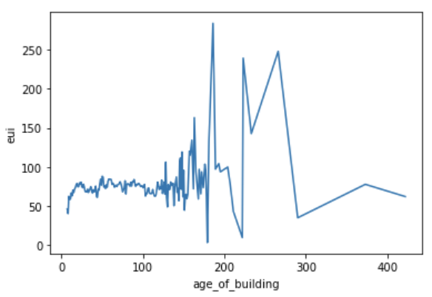
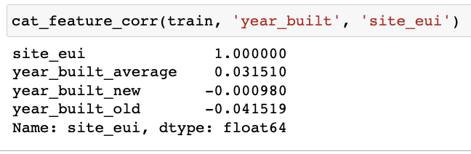
Age is a weak factor
Takeaways:
Older buildings could have been upgraded with newer eco-friendly features
Type of facility plays a big role

Slide 12
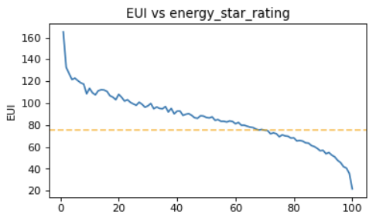
Energy Star Rating is a big factor
Takeaways:
Strongest indicator

Slide 13
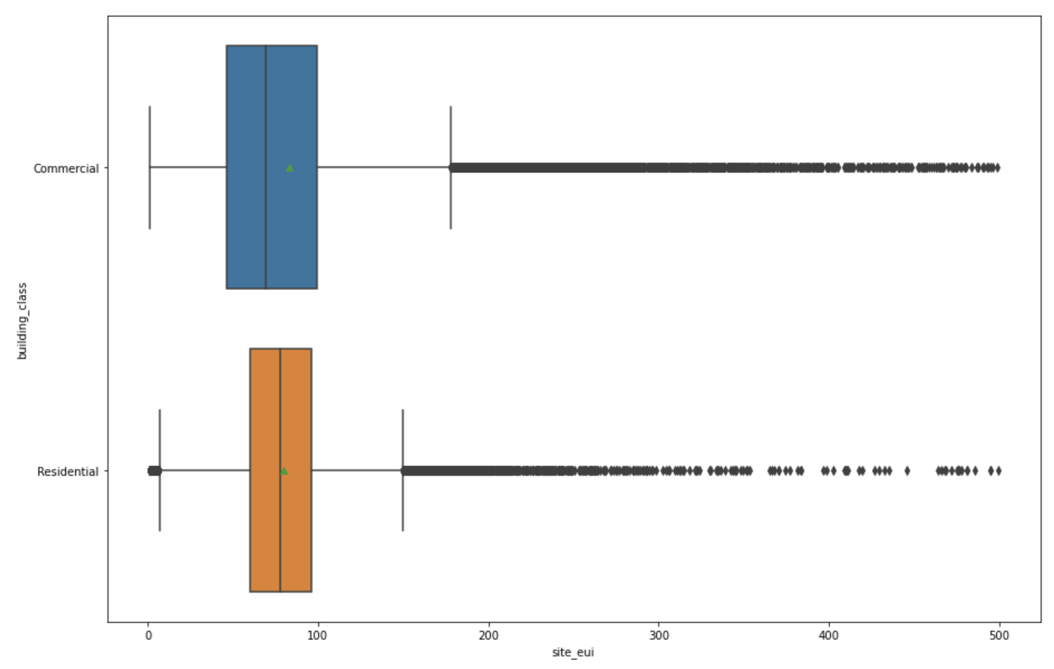
Commercial Buildings score better than Residential Buildings
Takeaways:
Distribution skews more left more Commercial Buildings
Commercial Buildings are more likely to invest in eco-friendly measures

Slide 14
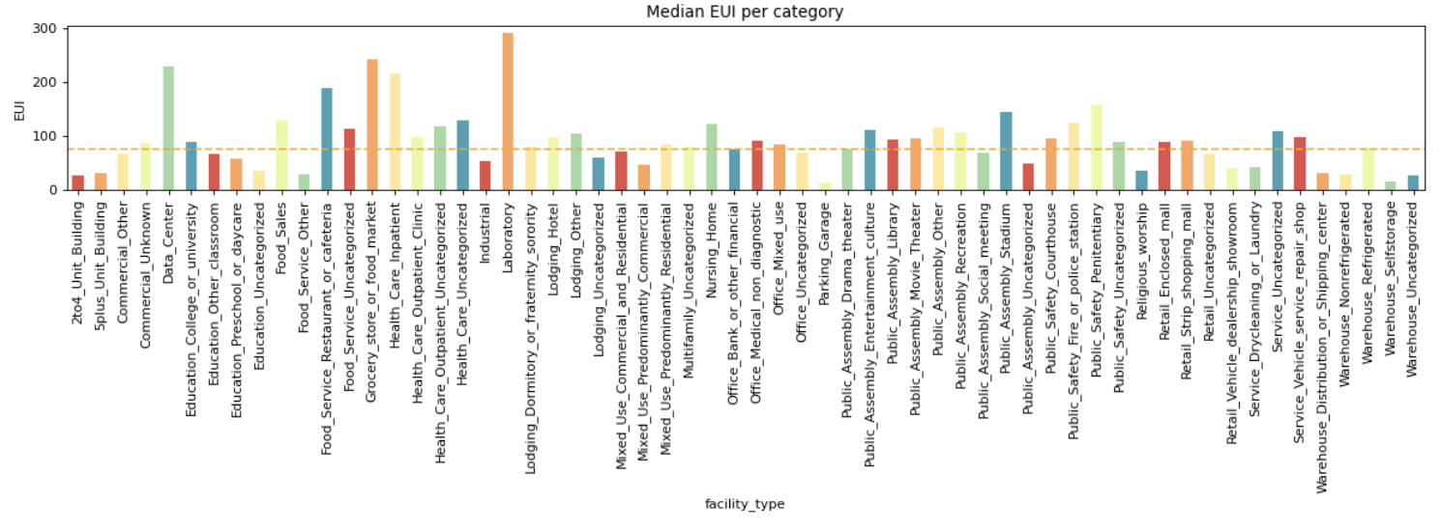
Type of facilities is important
Takeaways:
60 unique values
Good variance

Slide 15
Type of facilities is important
Takeaways:
Facilities that scores high EUI tends to be those that operate 24/7, uses energy-intensive equipment etc.
Data Centers, Hotels, Hospitals
Facilities that scores low EUI tends to be those that have large floor area, but the nature of operations is not energy-intensive
Warehouses, Worship Places, Parking Garage

Slide 16
Transforming Data
Modifying, Removing Variables
Handling Irregular Data
Converting Categorical Data
We change some variables to make it more useful.
For example, further segregating the commercial buildings to 2 classes (24/7 or not)
We remove some variables to reduce multi-collinearity
For example,
Min, Avg, Max temperature of each month
Understand why certain values are missing and construct meaningful ways to reassign values
Identify outliers and remove them as well
Our model needs numeric data to work with and we must convert categorical data to numeric form

Slide 17
Model Workflow
Set up X and y variables and perform train-test-split
Run selected models. Scale data if needed
Evaluate results of models
Refine variables and repeat

Slide 18
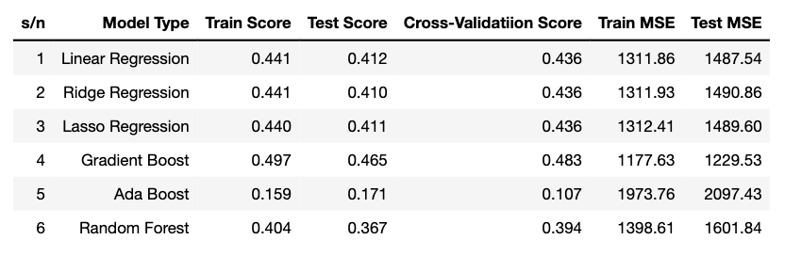
Model Findings
Selected Model: Gradient Boost

Slide 19
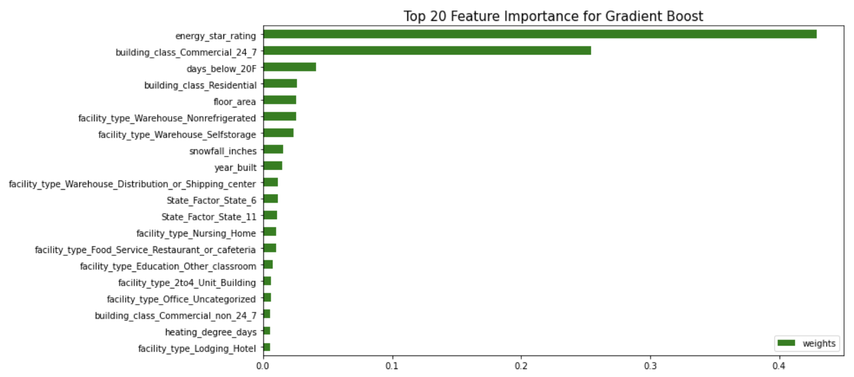
Model Findings
Takeaways:
Energy Star Rating
Building Class
Facility type
Cold Weather

Slide 20
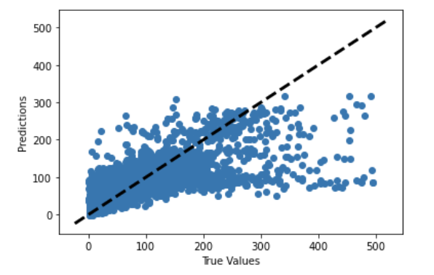
Model Findings
Takeaways:
Tendency to under-predict at high values

Slide 21
Conclusion
Energy Star Rating is the strongest indicator
SG Context: GreenMark
Expand building class to add more granularity
SG Context: BCA classifies buildings into 4 main categories (Residential, Commercial, Institutions & Industrial/Others)
Cold weather is a stronger predictor than warm weather
SG Context: Cooling appliances
Facility type is important
Currently have visibility of energy usage of 50+ buildings in Singapore

Slide 22
Future work
Build prediction model for each of the States
Include other features such as building coating material, upgrading works
Further segregate buildings by type of industry

Slide 23
Thank you!

Slide 24
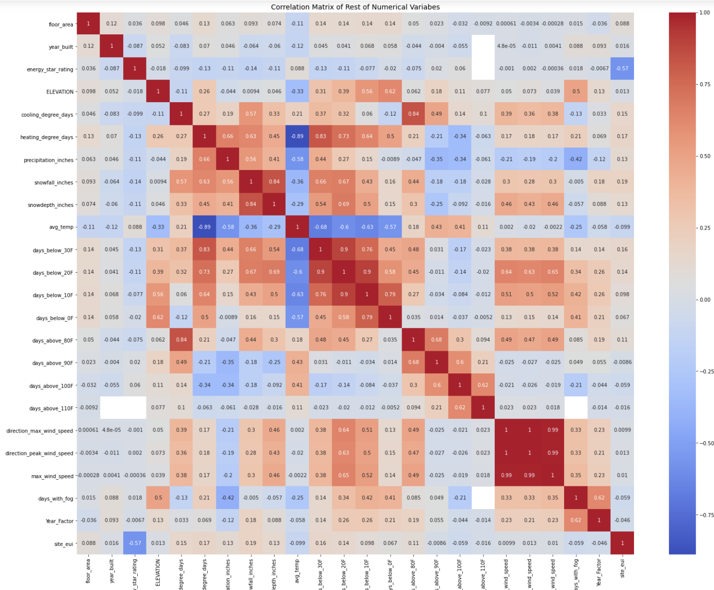
Appendix: Non-temperature

Slide 25
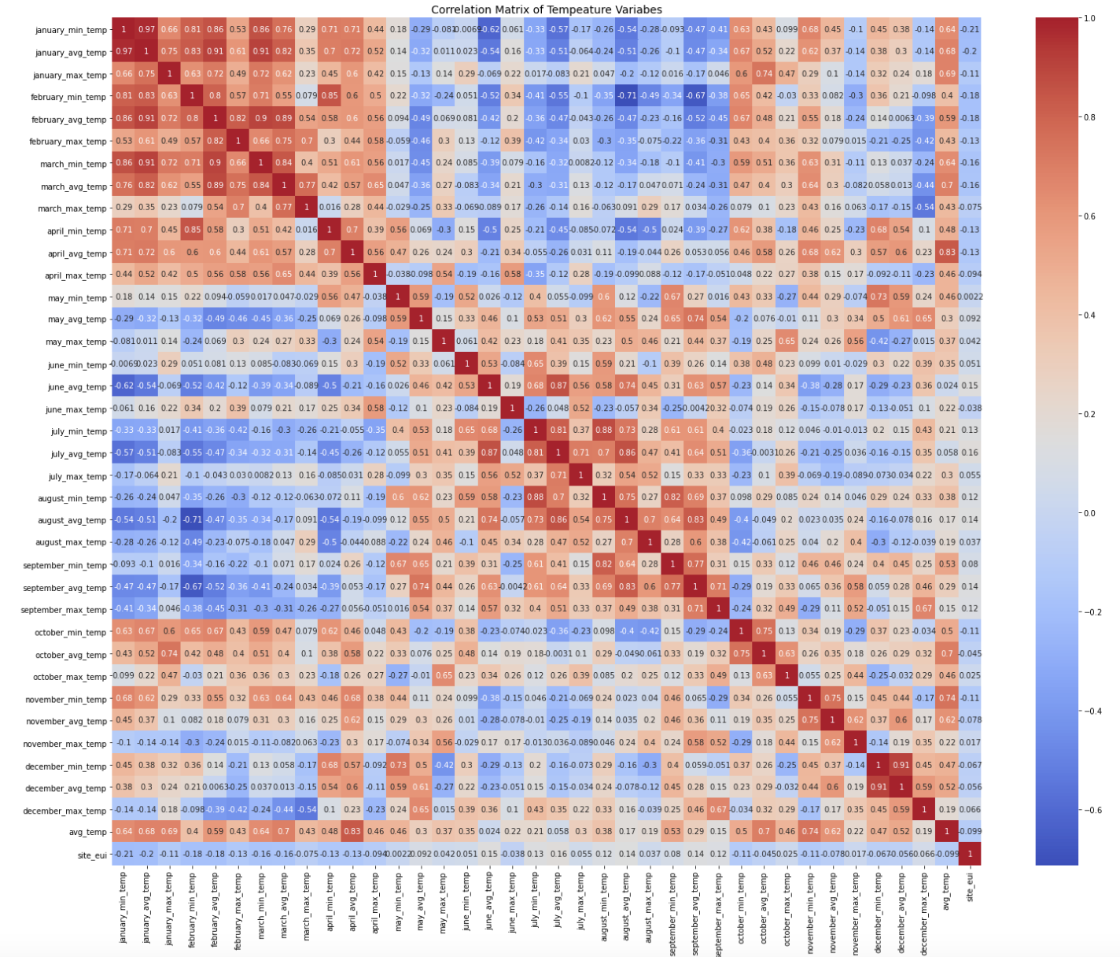
Appendix: Temperature

Slide 26
Appendix: Baseline Scores

